Slide 1
Modelling Colombian Economy: Stock-Flow Consistent Prototype Growth Model
An adaptation from Yilmaz & Godin (2020).

Slide 2
Structure of the presentation.
Changes included to the model
Changes not include into the code.
Baseline scenario.
Sensitivity analysis.

Slide 3
Changes included to the model.
Households loans demand.
Accelerator effect into the investment equation.
Central Bank does not purchase government bonds.
Government monetary transfers linked to a share of total population.
More detailed tax structure: consumption tax and royalties (proxy)
Autonomous exports.
Foreign Direct Investment
Further modifications to the external sector dynamics

Slide 4
Changes not include into the code.
Households loans demand. (desired credit demand)
Foreign Direct Investment
Capital utilization rate

Slide 5
Baseline scenario.
World GDP growths: 3%
Inflation rate: 4,6%
Exogenous capital flows: 0,005
Arbitrage parameter sensibility for capital flows and FX loans of the firms: 1
Exogenous cross border lending: 0,6

Slide 6
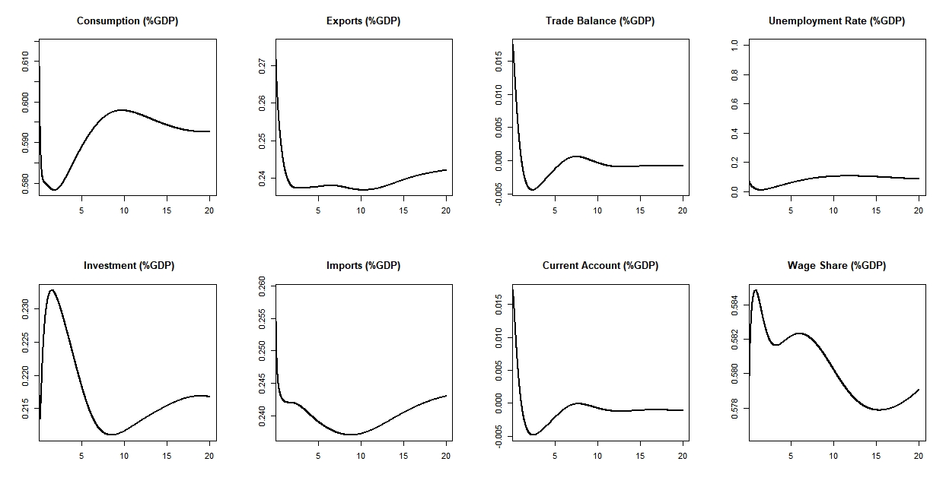
Baseline scenario

Slide 7
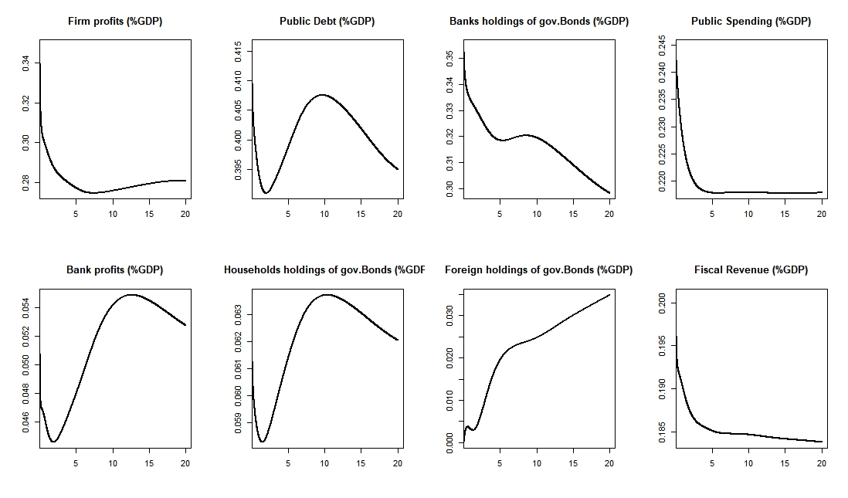
Baseline scenario

Slide 8
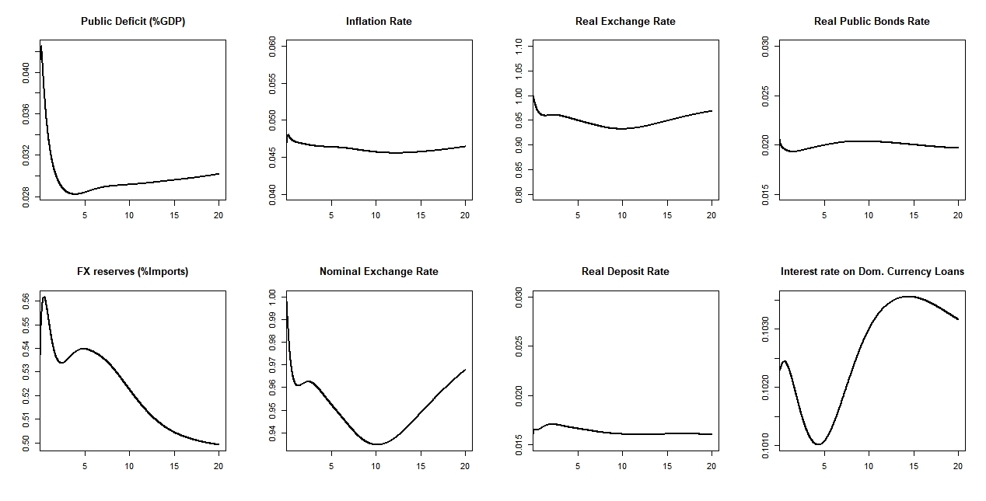
Baseline scenario

Slide 9
Sensitivity analysis.
 | Baseline scenario | Optimistic scenario | Negative Scenario
World GDP growth rate | 3% | 4,5% | 1,5%
Inflation rate | 4,6% | 5,5% | 3,5%
Exogenous capital flows | 0,005 | 0,01 | 0,0025
Arbitrage parameter sensitivity | 1 | 2 | 0,75
Exogenous cross border lending | 0,6 | 0,8 | 0,5

Slide 10
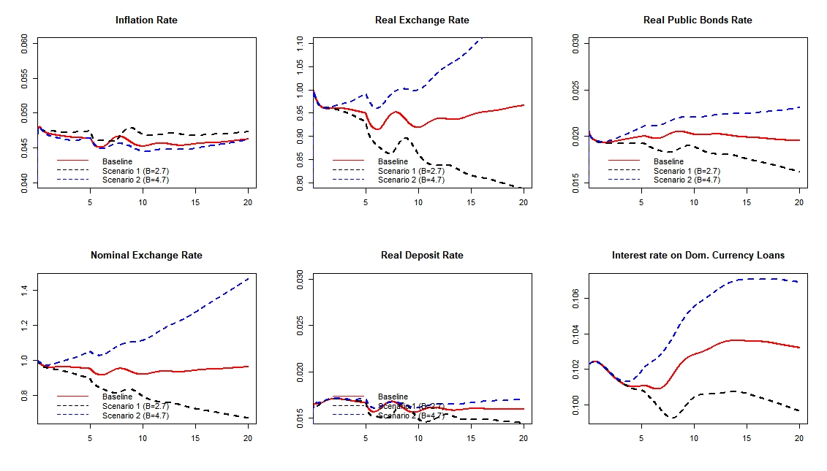
Sensitivity analysis.

Slide 11
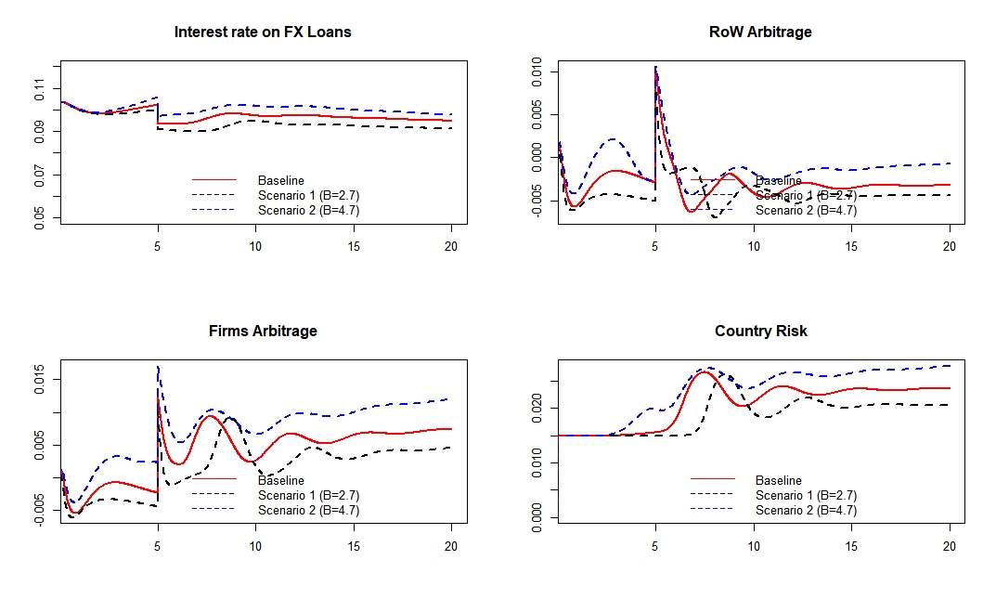
Sensitivity analysis

